Slide 1
Ames Iowa Housing Project
Mark Orland

Slide 2
Overview
The Data and Insights
Modeling
Results

Slide 3
The Data and Insights

Slide 4
About the Data
80 different features for assessing home value
20 Continuous
14 Discrete
46 Categorical
2009 to 2010
2930 observations
Notes:
20 Continuous
various area dimensions for each observation
lot size, as well as main living area, porches, basement
14 Discrete
number of items in each house
kitchen, bedrooms/bathrooms above and below ground, remodeling dates
46 Categorical
gravel or paved street
neighborhoods
building materials
dwelling type

Slide 5
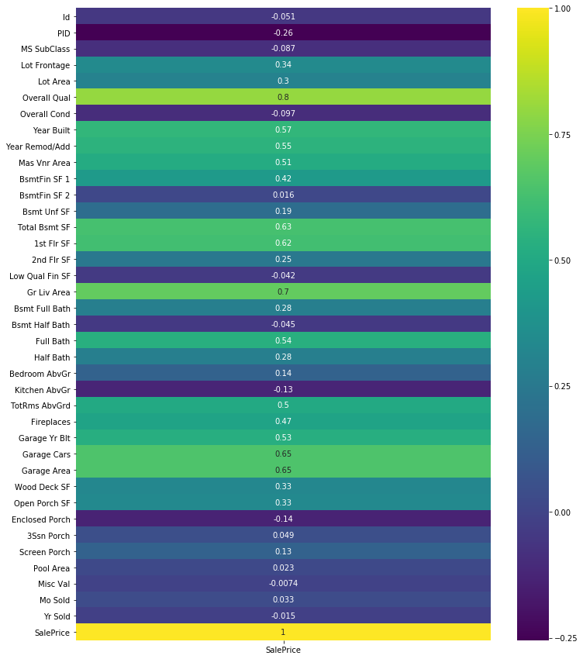
Heatmap
Ground Living Area
Total Basement Sq Ft
Overall Quality
Garage Cars

Slide 6
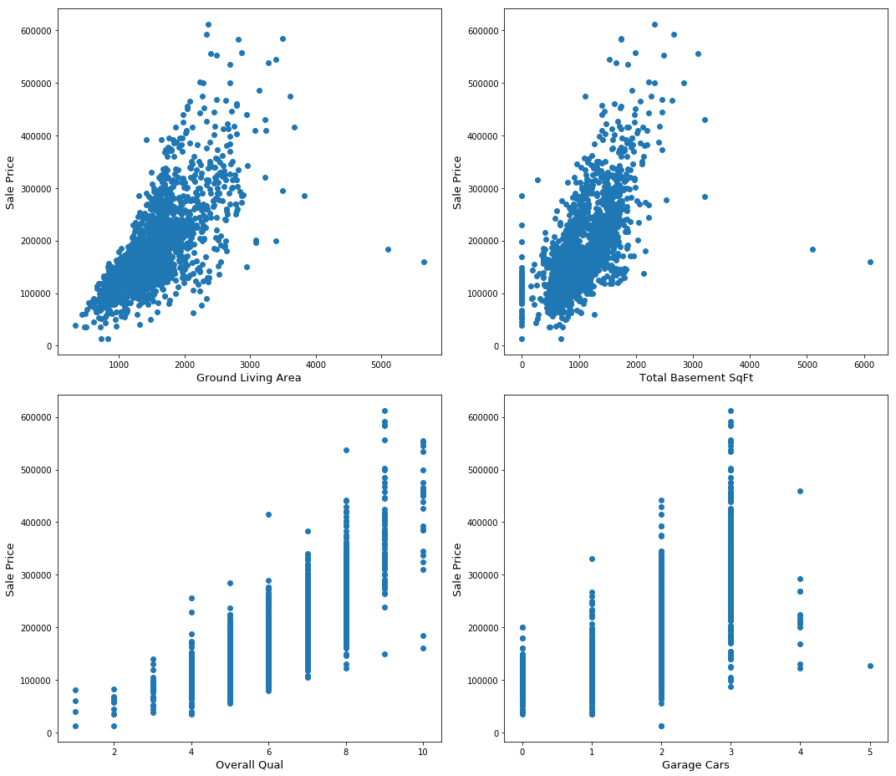
Scatterplots
Ground Living Area
Total Basement Sq Ft
Overall Quality
Garage Cars

Slide 7
Modeling

Slide 8
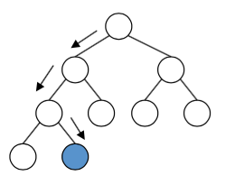
Gradient Boosting
Number trees → 200
Depth → 6
Strengths
Error correction
Weaknesses
Overfitting
Takes longer to run
Notes:
n_estimators → how many trees it
max_depth → how far down it goes
best value depends on the parameters and has to be tuned
Strength:
Each tree is build one at a time and corrects for what it learned in the last tree
--Random Forest all trees are independent and random → more robust and less likely to over fit
Weakness:
Overfitting → help prevent by using depth

Slide 9
Results

Slide 10
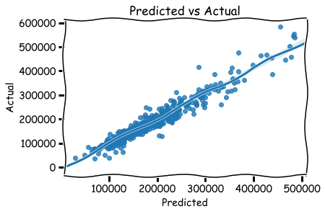
Notes:
R2 score of 91% up from 87% from linear regression
how close the data is fitted to the regression line
**Strong correlation between the predicted results and the actual results

Slide 11
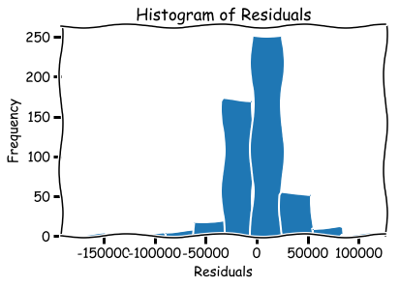
Notes:
Normally distributed –
assumptions for regression analysis is that the residuals are normally distributed
we can trust the regression results

Slide 12
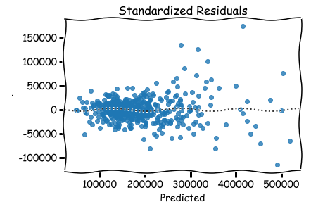
Notes:
distance from the line at 0 is how bad the prediction was for that value

Slide 13
Thank you
If you would like to have awesome plots like the ones shown, you can use plt.xkcd()
For more information please refer to the matplotlib documentation

